Slide 1
Learning Technical Fields
Lecturer: Ngo Huy Bien
Software Engineering Department
Faculty of Information Technology
VNUHCM - University of Science
Ho Chi Minh City, Vietnam
nhbien@fit.hcmus.edu.vn

Slide 2

Objectives
To learn a technical field by yourself.
To solve a problem using a systematic approach.

Slide 3

Contents
Terminologies
Hello World
The Examples
The Problem/Need
Problem Solving Approaches.

Slide 4

References

Slide 5

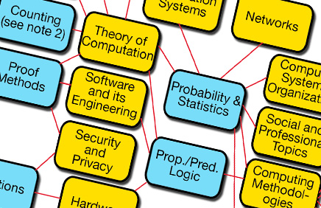
A Motivation to Learn Technical Field
1
Make money
Get a job (job requirement).
Startup (solving a problem)
Field selection
Theory
Practice
Hobby
Problem/need.
Open yourself up to new ideas and approaches.
2

Slide 6


We Need a Problem First!

Slide 7
If You Do Not Have a Problem Then
Find out technical terms
Sagas
CQRS
Event Sourcing
Indentify a small problem they solve using “good” tutorials.

Slide 8


I Know Nothing about this Domain
Existing systems
Similar systems
User guides
Installation guides
Technical documents
White papers
Books

Slide 9
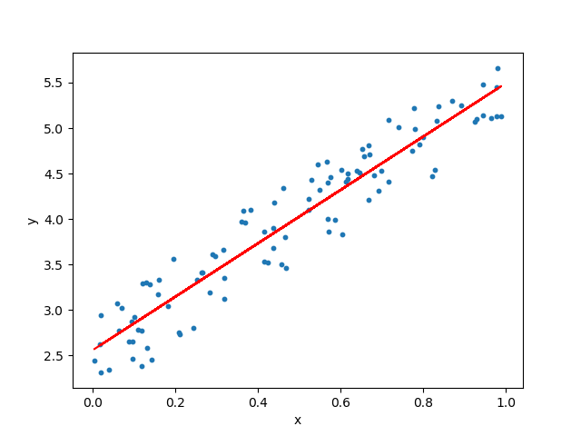
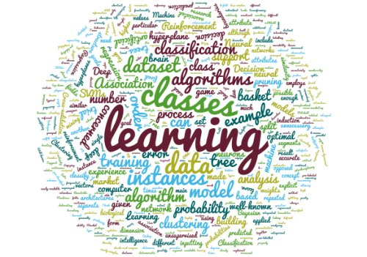
Learn Terminologies (aka Concepts) via Examples
Build a Hello World Example.

Slide 10

Work Out Examples

Slide 11

How Much Knowledge is Enough?
Problem (Problems/Use cases/User stories)
Reading (concepts, developer guide), asking, searching
Trying
Reading again, asking again, searching again
Trying again
Solution (Problems solved/Use cases/User stories implemented)

Slide 12


Slide 13

Why Build Background Knowledge?

Slide 14
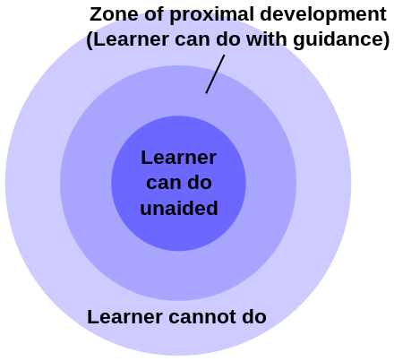
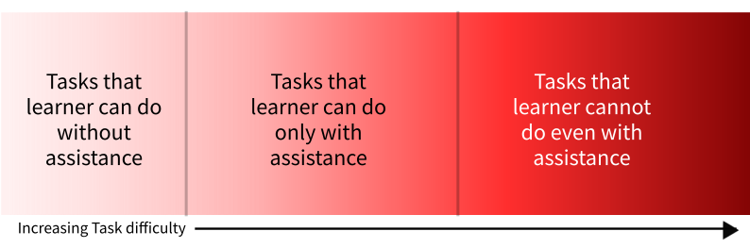

Zone of Proximal Development
Scaffolding
Teachers should assign tasks that students cannot do on their own, but which they can do with assistance; they should provide just enough assistance so that students learn to complete the tasks independently.

Slide 15

Revisit the Problem/Need

Slide 16
Problem Solving Approaches
Exhaustive search– using a systematic search for all possible solutions.
Hill climbing – making any move that approaches closer to the problem goal step by step.
Analysis and synthesis – reducing a given problem to a known category and then finding particular solutions.
Analogy – reducing a new problem to an existing or similar one for which solutions have already been known.
Divide-and-conquer – solving a whole problem via decomposing it into a set of sub-problems.

Slide 17
Example 1
Given existing .NET website source code.
Problem: Find security issues.
Background:
use manual inspection or
tools for automated inspection.
Exhaustive search:
Search for “.NET security issues scanner”, found many results
Hill climbing:
Select Roslyn Security Guard (no longer active) which leads to Security Code Scan
Security Code Scan requires Visual Studio 2015, install VS 2015, import website codebase
Do not know how to use the tool, read manual https://security-code-scan.github.io/

Slide 18
Example 2
Problem: Is it possible to create a component in APEX with an OCR source package?
Terminologies:
What is APEX?
What is OCR source package.
Exhaustive search: Searched for “APEX”, found Introducing Apex.
It is not possible to integrate a .NET library directly to APEX component.
Exhaustive search: Searched for “call web service in APEX”, found Integration and Apex Utilities. It is possible to call a web service inside an APEX component.
Exhaustive search: Search for “OCR API web service”, found https://cloud.google.com/vision/docs/ocr , https://azure.microsoft.com/en-us/services/cognitive-services/computer-vision/, https://ocr.space/ocrapi
Analysis and synthesis: Build a private web service using OCR source package.

Slide 20
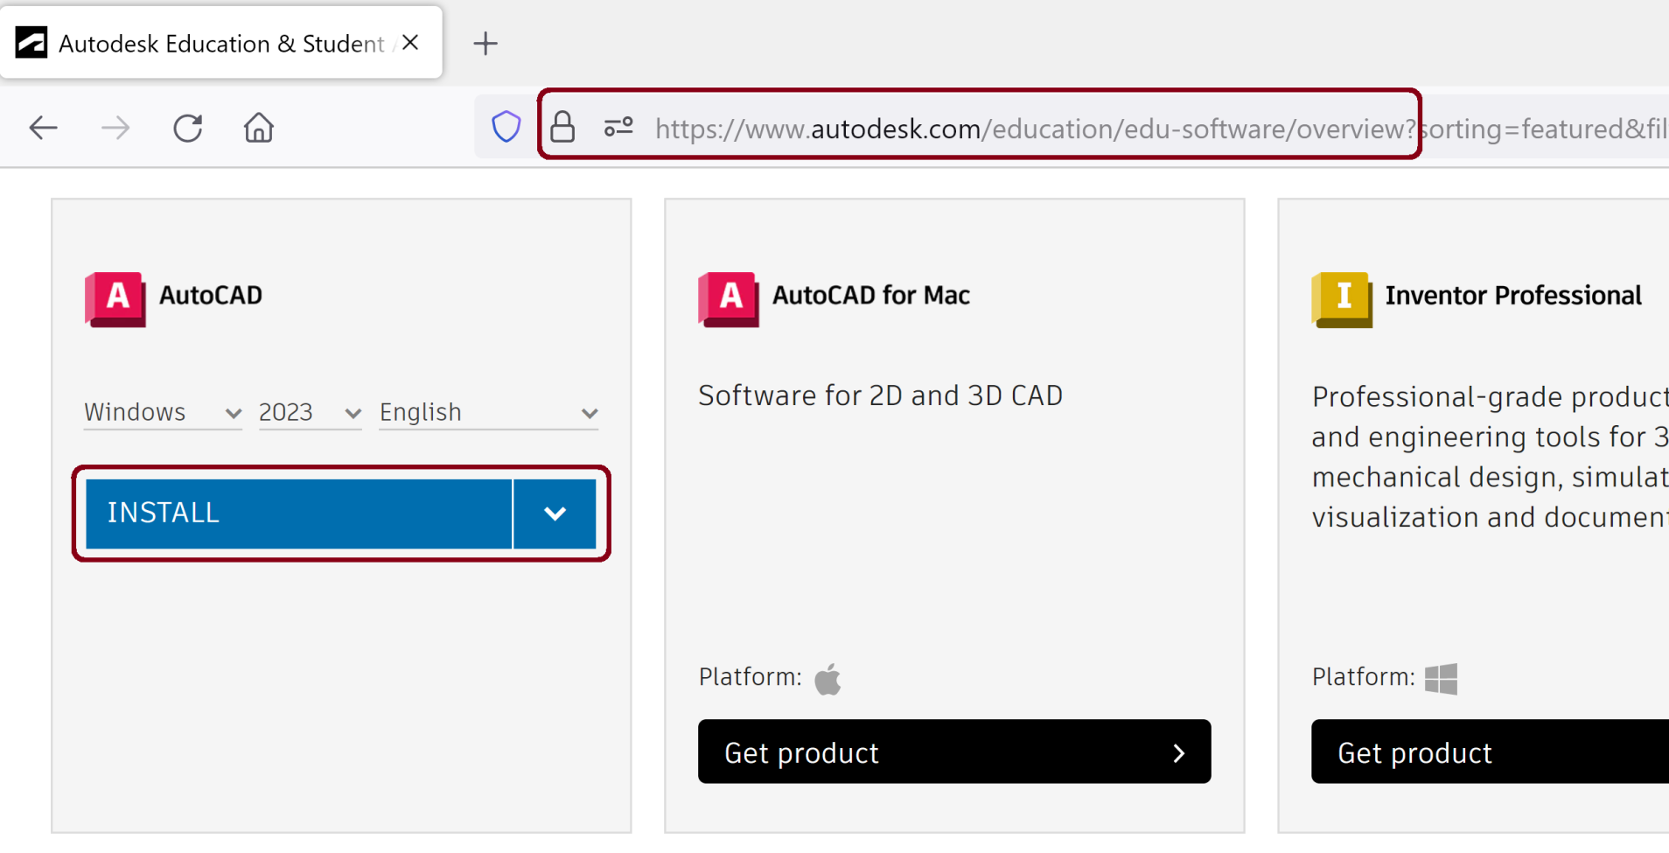
1. Download AutoCAD

Slide 21
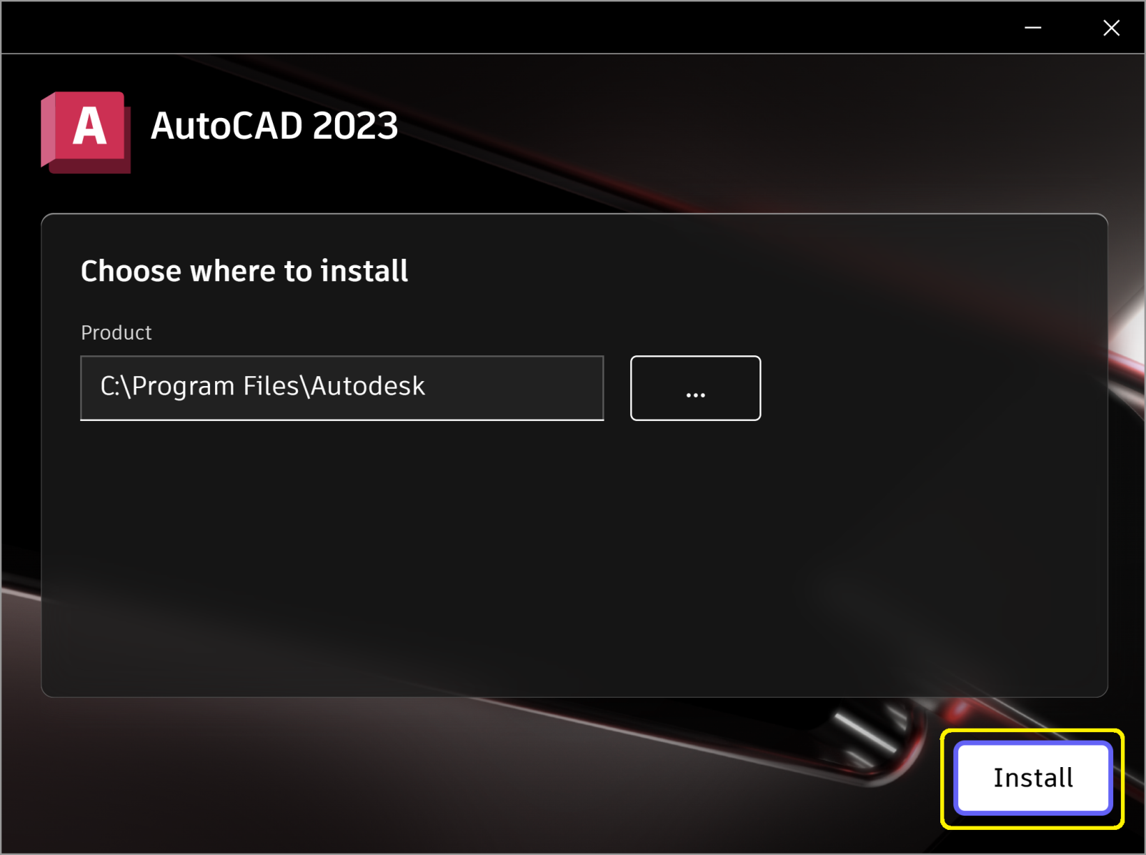
2. Install AutoCAD

Slide 22
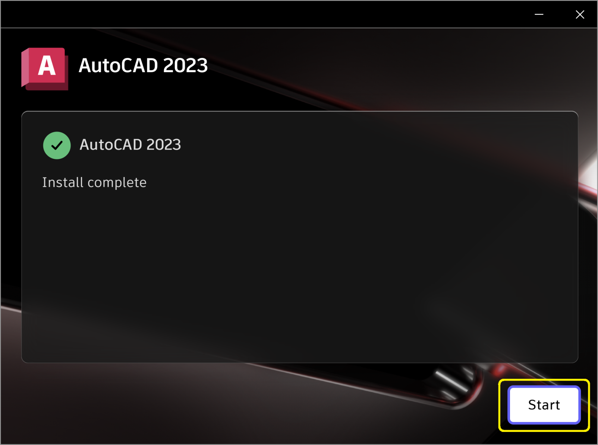
3. Review Successful Completion

Slide 23

Thank You & See You Again

